Slide 1
Rhythm of Success
Analyzing Trends in East Asian Music Popularity
CS 131 Final Project
Search
Home
Library
Team 8: Tien Ly, Jewon Yeon, and Divij Gupta

Slide 2
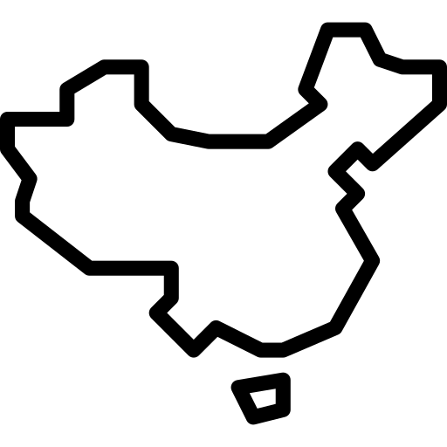
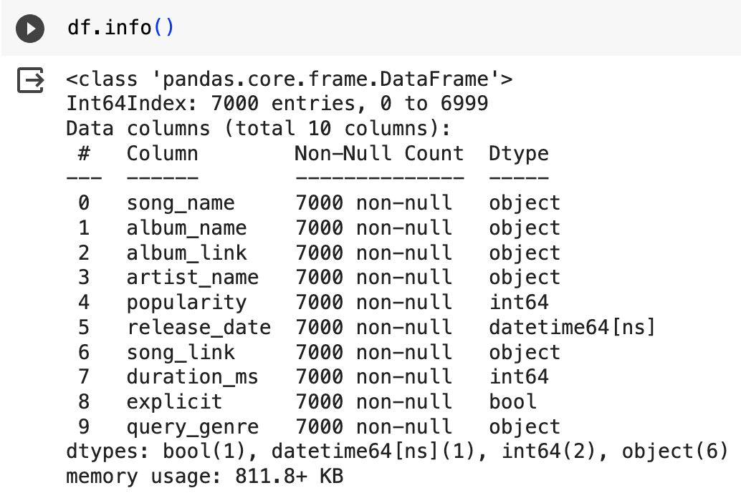


Spotify Popular East Asian Tracks
CS 131 Final Project
Top 1000 tracks from each of the 7 'query genres' sourced from the Spotify API: chinese, japanese, korean, k-pop, j-pop, j-idol, and j-dance
Notes:
Data was extracted using Spotify API
Last updated 4 months ago (July 2023)
Some tracks/artists may be duplicated due to them being on two or more query genres
Number of entries and the columns

Slide 3
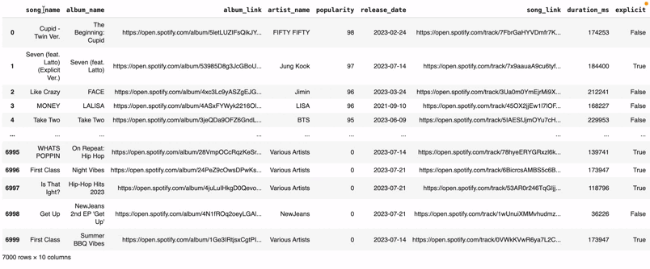
Dataset Metadata
popularity: a popularity metric calculated by Spotify, ranging from 0-100 with 100 being the most popular, a song that is popular recently is more likely to have a higher score than a popular song in the past
duration_ms: duration of the song in milliseconds
Notes:
Popularity
Duration

Slide 4

Project Objective: Explore the characteristics that could be used to predict a song's likelihood of becoming popular

Slide 5
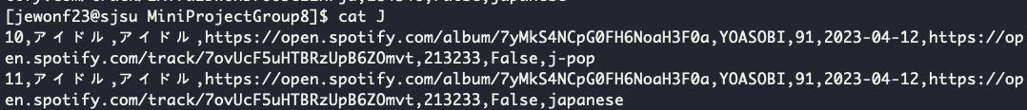
Data Pre-Processing
$ grep -i -e 'japanese' -e 'j-pop' -e 'j-dance' -e 'j-idol' east_asia_top_tracks.csv > japanese
$ awk 'BEGIN {FPAT = "([^,]*)|(\"[^\"]+\")"} $6 >= 70 && $6 <= 100 {print $0}' japanese > J
$ awk 'BEGIN {FS = ","; OFS = ","} {print $2, $3, $4, $5, $6, $7, $8, $9, $10}' J | sort -u > FJ
Only keep songs with a popularity between 70 and 100

Slide 6
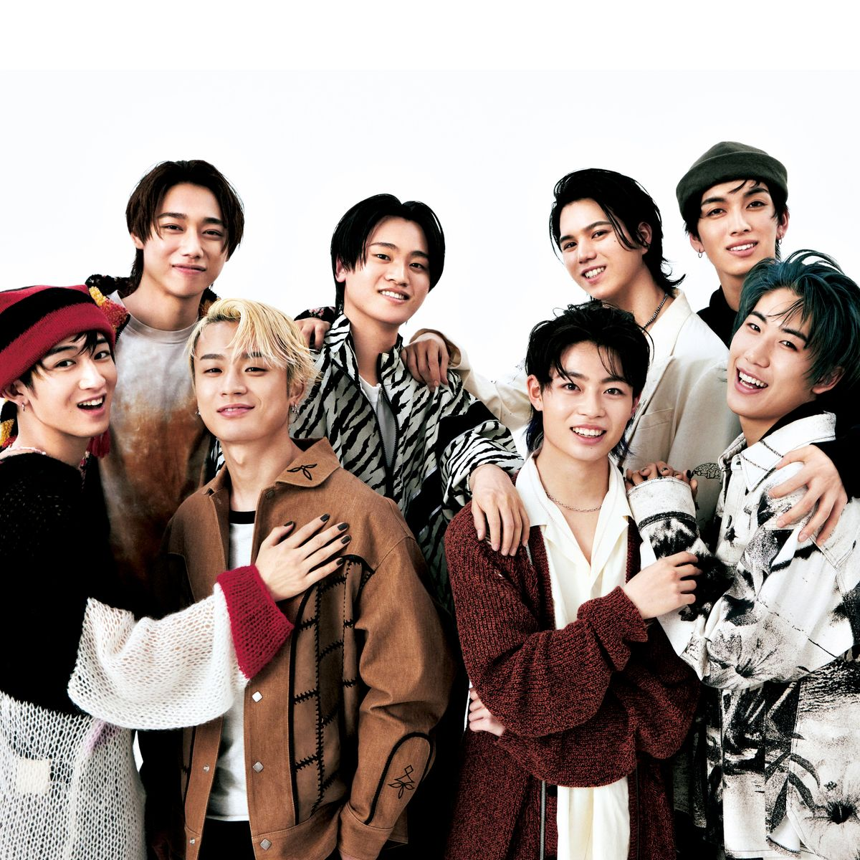
Task 1:
Song Length and Explicit Content
CS 131 Final Project
Search
Home
MAZZEL (マーゼル)
Library
Hypothesis: Songs that are shorter and non-explicit have a higher chance of becoming a hit.

Slide 7
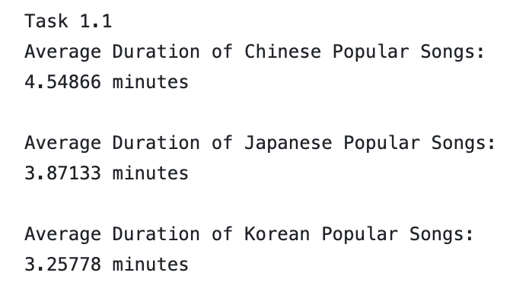
Task 1.1: Average Duration
#1
3.25778 minutes
Korean Songs
#2
3.87133 minutes
Japanese Songs
#3
4.54866 minutes
Chinese Songs
$ awk 'BEGIN {FPAT = "([^,]*)|(\"([^\"]|\"\")*\")"; sum = 0; print "Average Duration of Japanese Popular Songs:"} {sum += $8} END {print sum / NR / 60000 " minutes"; printf "\n"}' japanese >> task1.txt

Slide 8
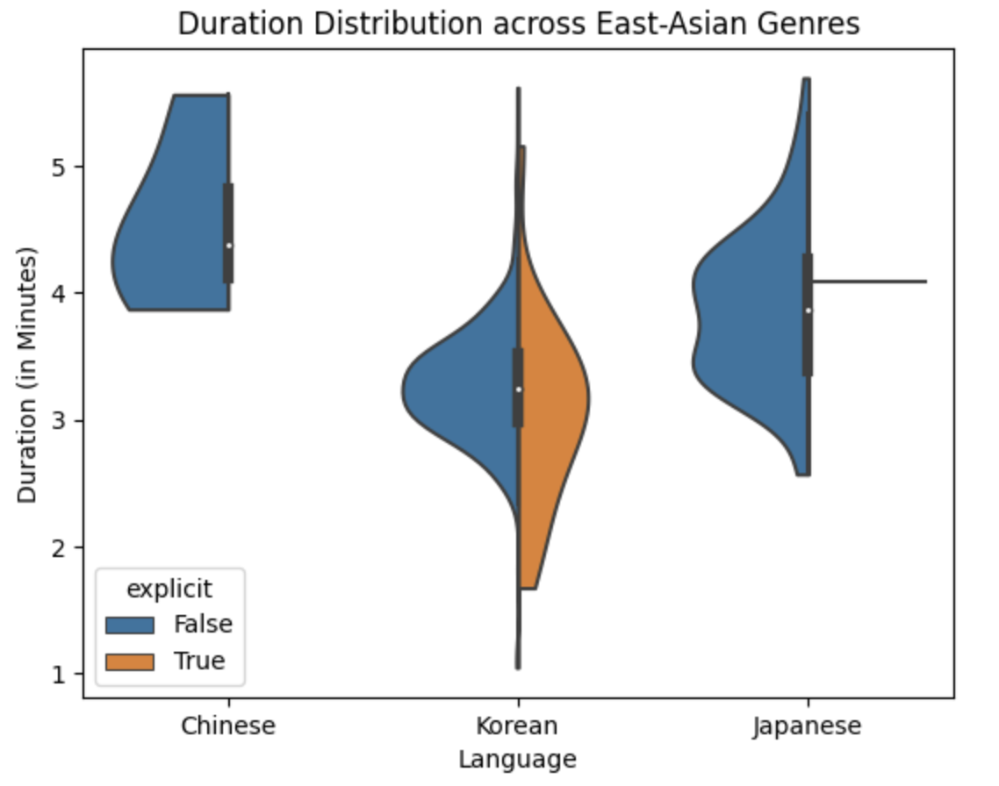
Task 1.1: Visualizations

Slide 9
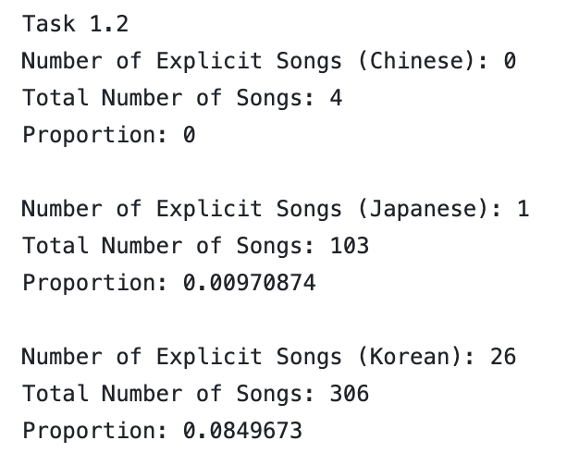
Task 1.2: Proportion of Explicit to Non-Explicit Songs
$ awk 'BEGIN {FPAT = "([^,]*)|(\"([^\"]|\"\")*\")"; explicit_count = 0} {if ($9 == "True") explicit_count++} END {print "Number of Explicit Songs (Korean): " explicit_count; print "Total Number of Songs: " NR; print "Proportion: " explicit_count / NR}' korean >> task1.txt

Slide 10
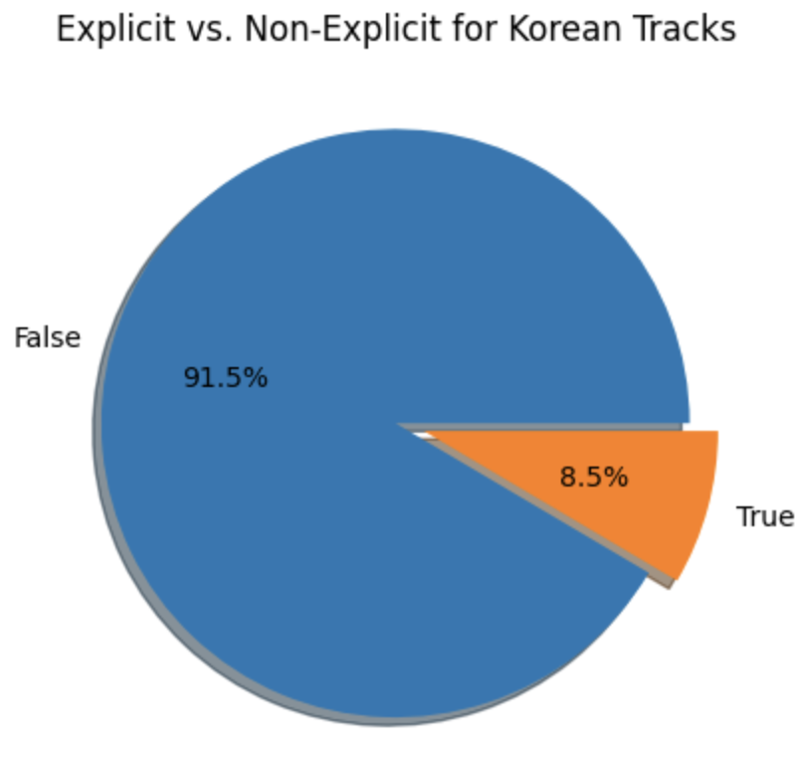
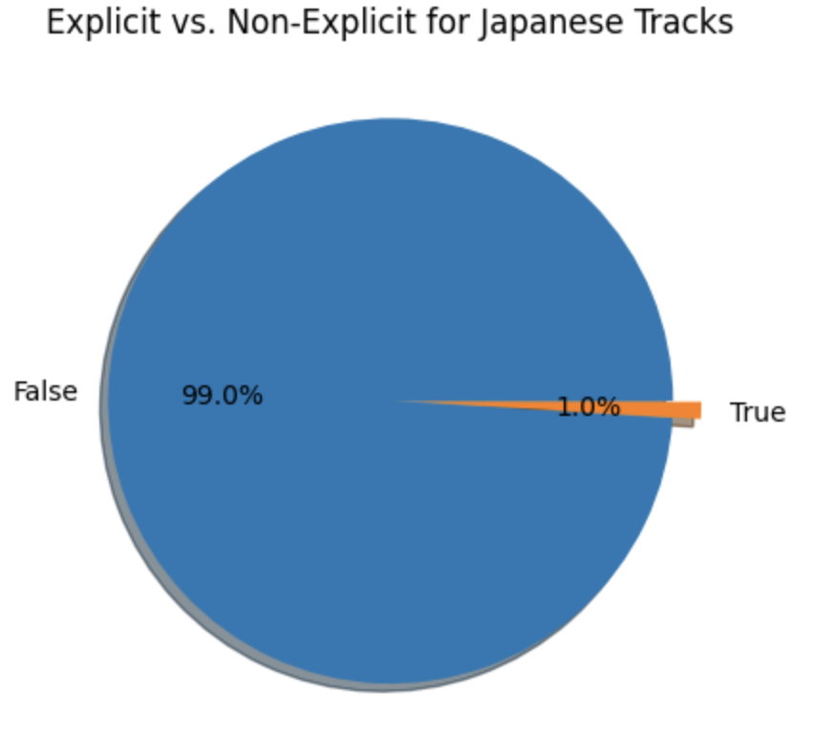
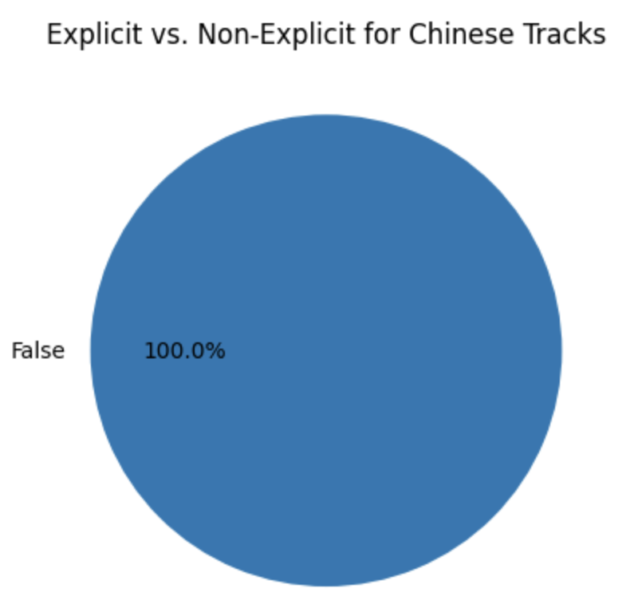
Task 1.2: Visualizations
Order by
Korea
Japan
China

Slide 11

CS 131 Final Project
Search
Task 2: Popular Artists and Songs Over Time
Home
Library
IVE (아이브)
Explore the artist_name and release_date columns to understand the popularity of artists and identify timeless songs

Slide 12
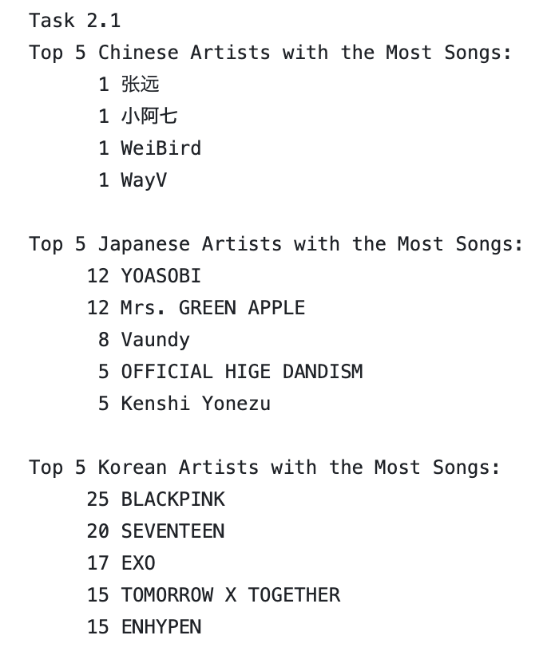
Task 2.1: Top 5 Artists
Artists
$ awk 'BEGIN {FPAT = "([^,]*)|(\"([^\"]|\"\")*\")"} {print $4}' chinese | sort | uniq -c | sort -nr | head -n 5 | awk 'BEGIN {print "Top 5 Chinese Artists with the Most Songs:"} {print} END {printf "\n"}' >> task2.txt

Slide 13
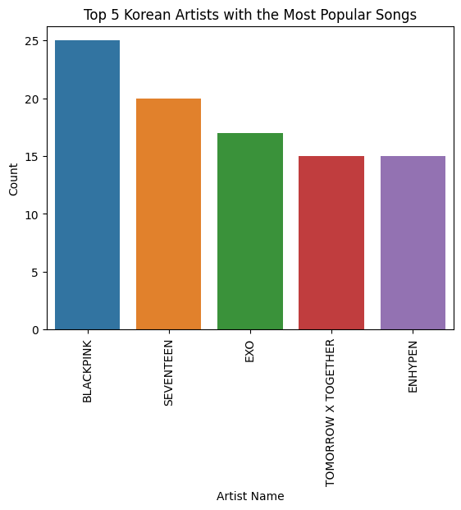
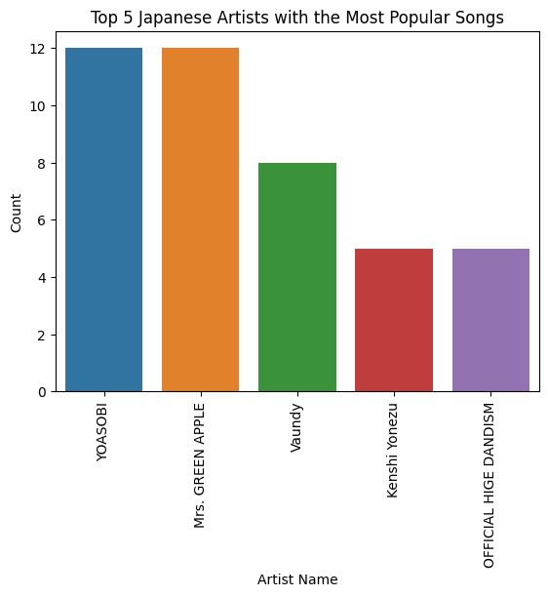
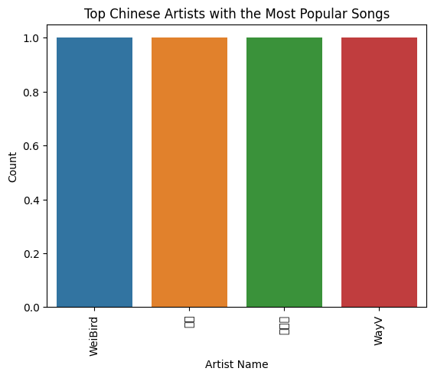
Task 2.1: Visualizations
Korea
Korea
Japan
China
Follow
Follow
Follow
Follow

Slide 14
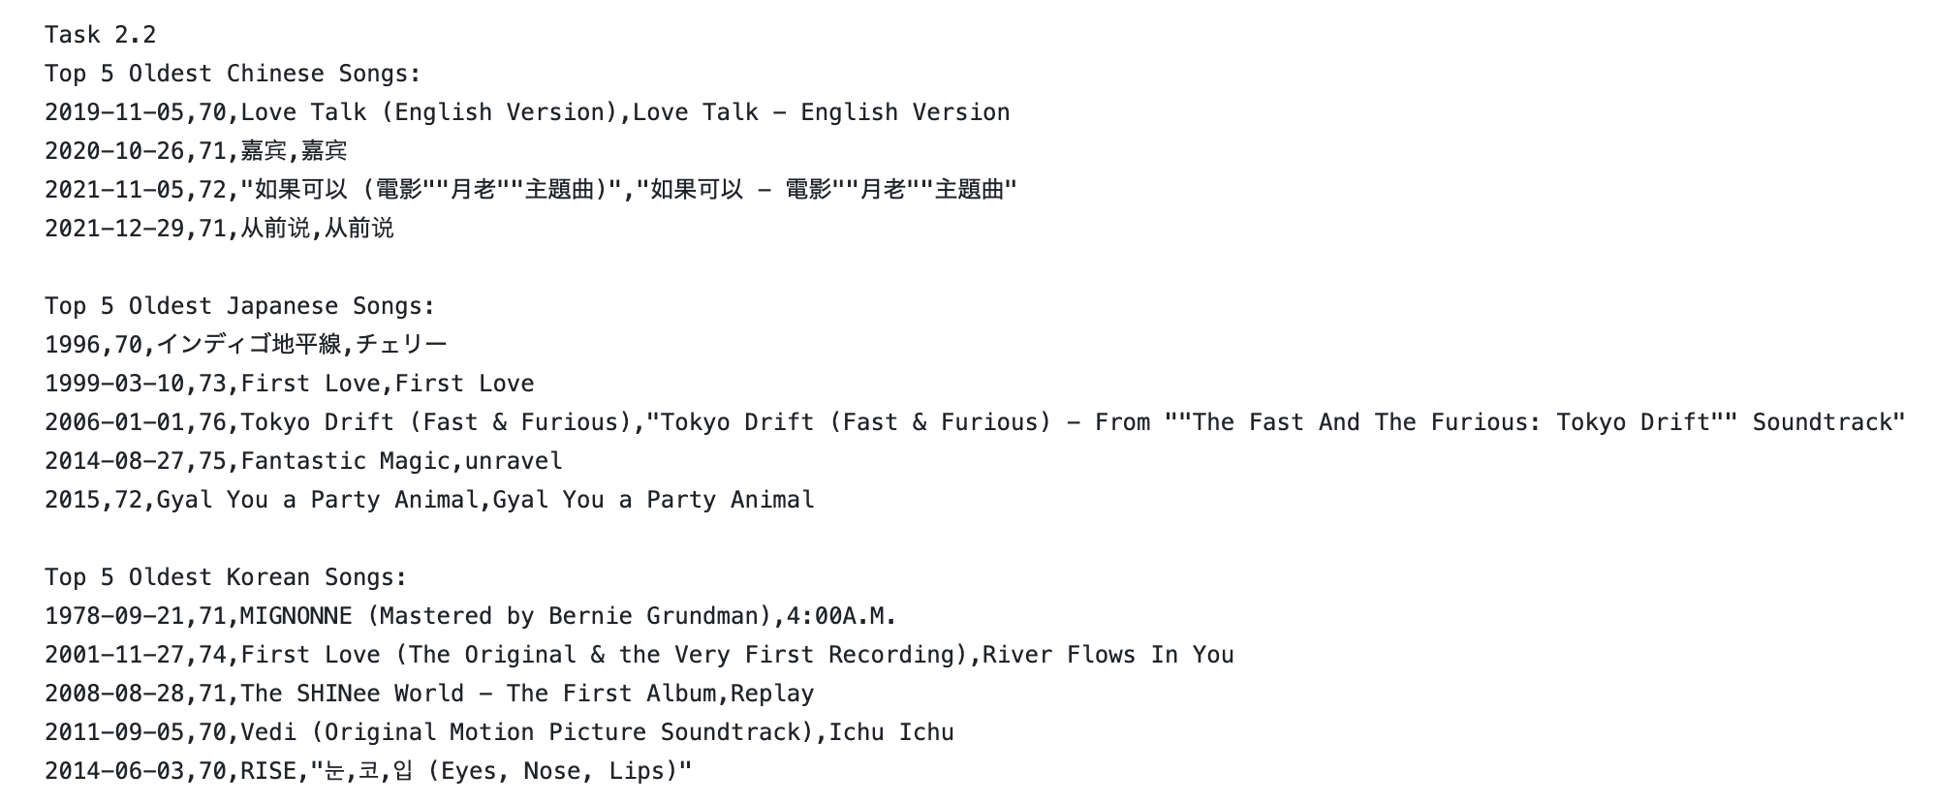
Task 2.2: 5 Oldest Songs
$ awk 'BEGIN {FPAT = "([^,]*)|(\"([^\"]|\"\")*\")"; OFS = ","} {print $6, $5, $2, $1}' korean | sort -t, -k1,1 | head -n 5 | awk -F, 'BEGIN {OFS = ","; print "Top 5 Oldest Korean Songs:"} {print}' >> task2.txt

Slide 15
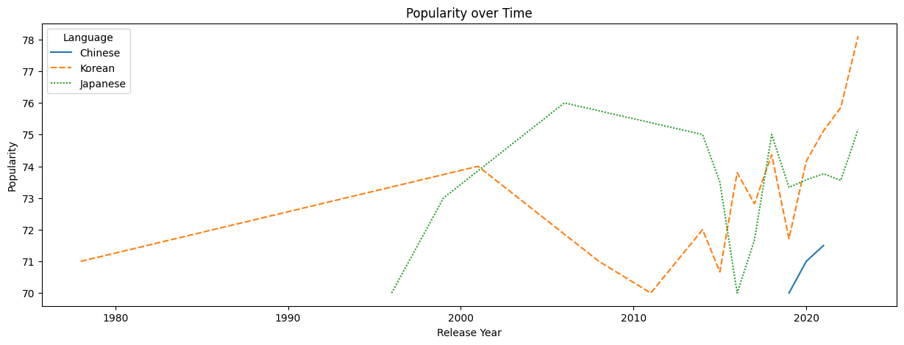
Task 2.2: Visualizations

Slide 16
Conclusion
CS 131 Final Project
Search
Home
Non-explicit songs tend to be more popular than explicit ones.
No definite relation found between the duration of a song and its popularity.
More recent songs tend to be more popular than older ones.
Some artists tend to have more popular songs than others.
Library

